Slide 1
Agenda
System Design Case Studies
System Design Consideration Steps
Tools to Make Diagrams
Design Scalable System from 0 to Millions of Users
Design A WhatsApp like Chat System
Design An Instagram like App
Design A Booking.com Hotel Reservation System
Design A Netflix Like Video Platform
Design A Flipkart like ECommerce Platform
Design An OLA Like Taxi System

Slide 2
System Design Consideration Steps
Understand System Requirements
  Functional: What the system must do (e.g., process payments).
  Non-Functional: How the system performs tasks (e.g., response time).
Identify the Scope: Define the limits of what the system will and won't do.
Capacity Estimation and Constraints: Predict resource needs and identify any limitations.
System APIs: Specify how external systems interact with it (e.g., RESTful interfaces).
Database Design and Model: Structure how data is stored and accessed (e.g., schema design).
High Level Design (HLD): A broad view of the system components and their interactions.
Detailed Design (LLD): In-depth specifics of each component’s operation and data flow.
Scalability and Performance: Plan for growth and ensure the system stays efficient under load.
Security and Compliance: Protect against threats and ensure regulatory adherence.

Slide 3
Tools to Make Diagrams
Draw.io/Diagrams.net
Excalidraw.com
Lucid chart
Microsoft Visio
Canva

Slide 4
A Scalable System from 0 to Millions of Users

Slide 5
#1. Design a Scalable System from 0 to Millions of Users
Problem Statement: Develop a scalable and high-performance application designed to efficiently manage and serve a large user base, potentially exceeding 500 million users globally, while ensuring low latency and a seamless user experience.
Key Requirements
Scalability: The architecture must support horizontal scaling to accommodate a rapidly expanding user base while maintaining performance.
Low Latency: Implement optimization strategies to achieve low response times, regardless of user location.
Geographical Distribution: Incorporate a geo-distributed infrastructure to serve users with data centers positioned in strategic global locations to minimize latency.
Components: Design a robust ecosystem consisting of a web application, a native mobile application, a scalable database, and an intelligent caching mechanism for data retrieval.

Slide 6
System Requirements and Goals
Functional Requirements
  A functionality for user's management.
  The system should deliver content to users based on their geography.
  The system should provide users with the ability to submit, retrieve, and manipulate data in real-time and support data synchronization across the web and mobile.
  The application must send real-time notifications to users’ devices.
Non-functional Requirements
  The application should have a response time of less than 200 milliseconds.
  The system must guarantee an uptime of 99%.
  The system should handle spikes in the user traffic. It must allow for horizontal and vertical scaling.

Slide 7
Capacity Estimation
Considering a user base 500 million, with 2 million active daily users
Consider each user on average generate data of size 200 KB.
Total space required for 1 day of data
  2M * 200KB ≅ 381 GB
Total space required for 5 years:
  381 GB * 365 * 5 ≅ 679 TB

Slide 8
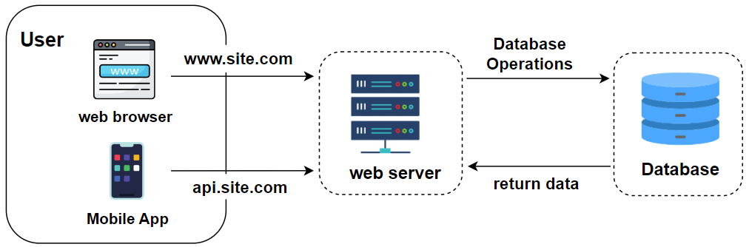
Step1: High Level System Design

Slide 9
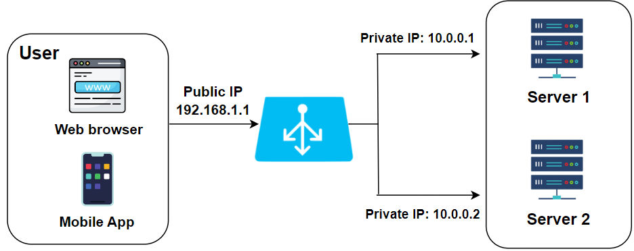
Step2: Load Balancing

Slide 10
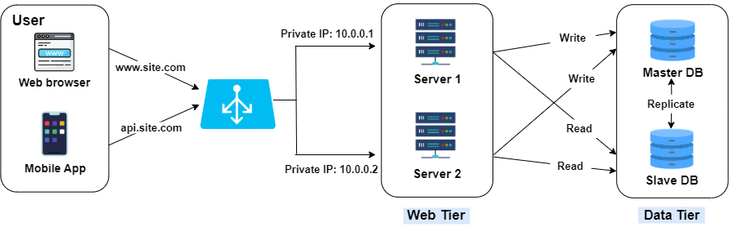
Step3: Database Replication

Slide 11
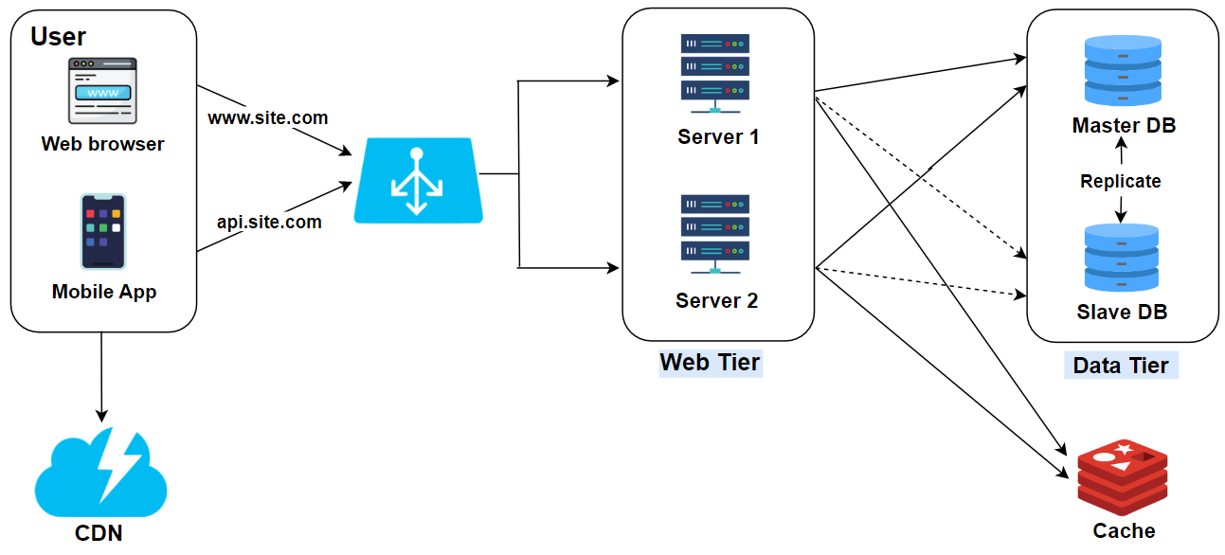
Step4: Cache and CDN

Slide 12
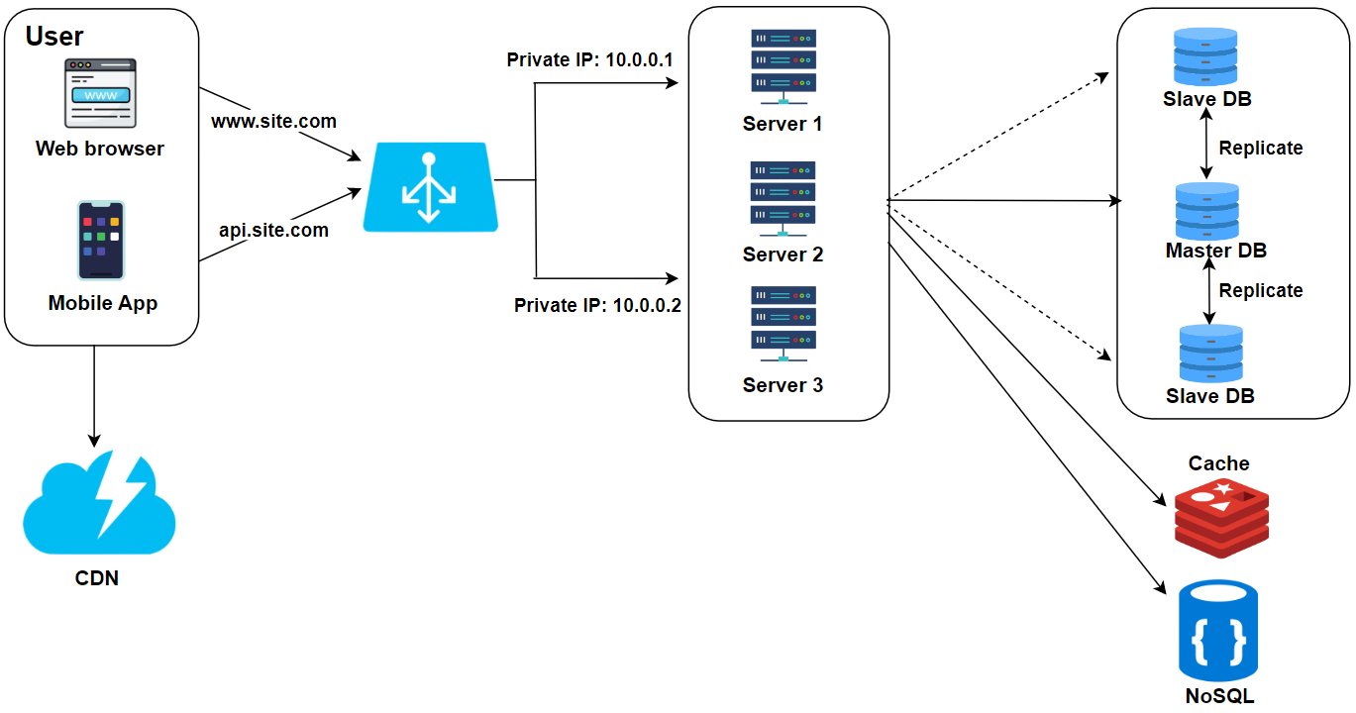
Step5: Stateless architecture

Slide 13
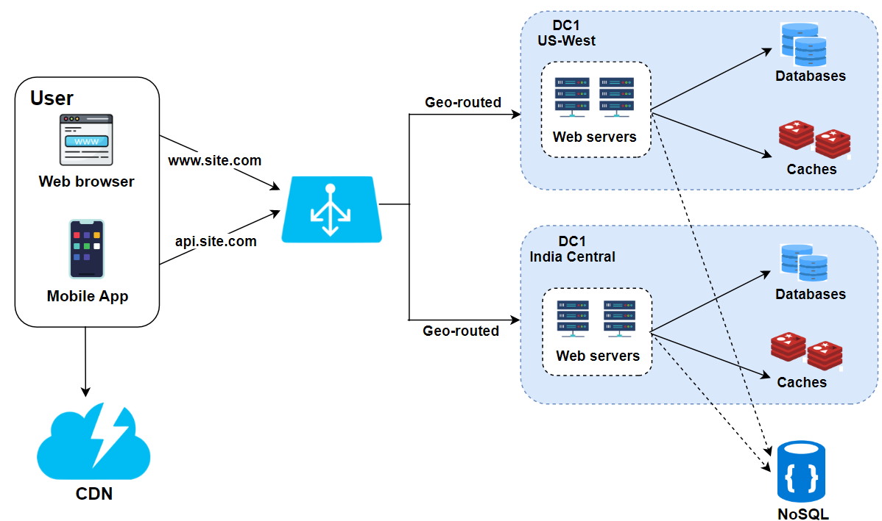
Step6: Traffic Manager

Slide 14
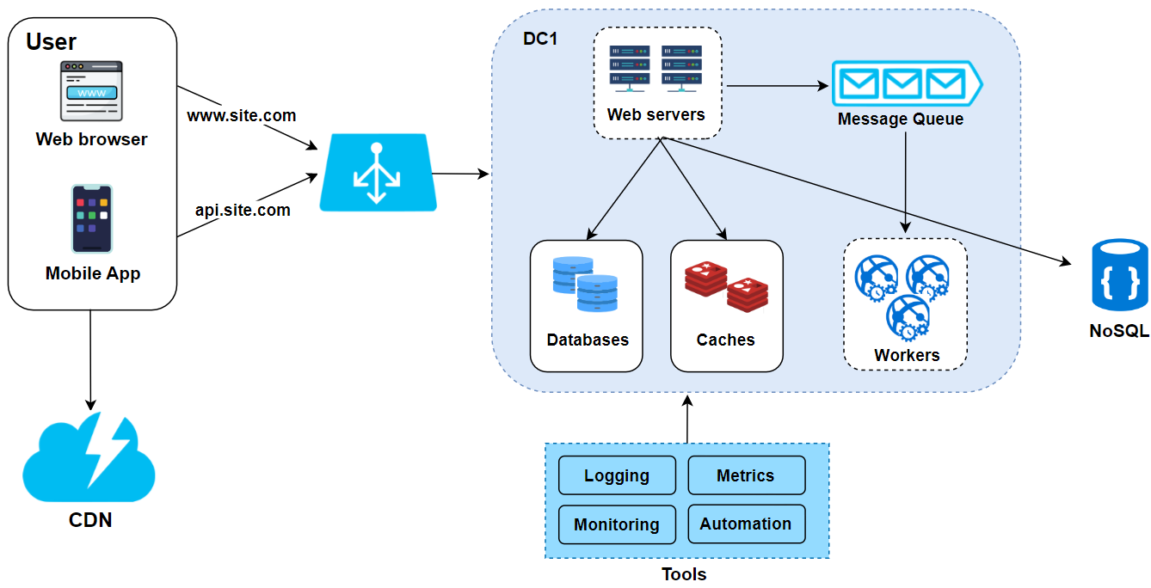
Step7: Messaging, Logging, Metrics and Automation

Slide 15
WhatsApp like Chat System Design

Slide 16
#2. Design A WhatsApp like Chat System
Problem Statement: Design a robust and scalable chat system that facilitates real-time messaging between users through web and mobile interfaces. The system will support one-on-one conversations, group chats, and the ability to share multimedia messages. Users should be able to see message read-receipts, online statuses. The chat interface will be intuitive and user-friendly, ensuring a seamless communication experience.
Out of the Scope: Video and voice calling features, integration with social media platforms, chatbot functionalities, and encrypted secret chats will not be included in this version of the system.

Slide 17
System Requirements and Goals
Functional Requirements
  The system should support one-to-one and group chat among users.
  The system should monitor and display whether users are online or offline.
  The system should keep track of chat history.
Non-functional Requirements
  The system should offer a real-time chatting experience.
  The system should support strong consistency, ensuring that users have access to the chat history across all their devices.
  The system should be highly available and consistent.

Slide 18
System Design Considerations
The system is expected to be highly available and support low latency; emphasis will be placed on constructing an architecture optimized for real-time chat.
Users will have the capability to send message to unlimited numbers of users.
Users can create unlimited numbers of groups for chat.
The system will be engineered to deliver messages in real-time.
Ensure complete data integrity, providing a guarantee that no message will ever be misplaced or lost.

Slide 19
Capacity Estimation
Considering a user base 500 million, with 2 million active daily users
1
Consider each user on average generate data of size 200 KB.
2
Total space required for 1 day of data
3
2M * 200KB ≅ 381 GB
Total space required for 5 years:
4
381 GB * 365 * 5 ≅ 679 TB

Slide 20
Capacity Estimation: Assumption
Considering a user base 10 million, 1 million active users
Average message size: 100 bytes
Each user sends 40 messages per day
Each user participates in 5 groups, with 100 messages per group per day
10% of messages contain media files, with an average size of 2 MB
New user growth rate: 5% per month
Data retention: 1 year
Data replication factor: 3 (for redundancy)
Daily logs and backups are 10% of the daily message volume

Slide 21
Capacity Estimation: Calculation
Storage for messages:
Text messages per user per day: 40 messages * 100 bytes = 4 KB
Text messages for all users per day: 4 KB * 1 million = 4 GB
Group messages per user per day: 5 groups * 100 messages * 100 bytes = 50 KB
Group messages for all users per day: 50 KB * 1 million = 50 GB
Total text messages per day: 4 GB + 50 GB = 54 GB
With 10% growth for messages: 54 GB * 1.1 = 59.4 GB
Annual storage for text messages: 59.4 GB * 365 days = 21.681 TB
Storage for media files:
Media messages per day: 1 million users * 40 messages * 10% = 4 million media messages
Total size of media messages per day: 4 million * 2 MB = 8 TB
Annual storage for media messages: 8 TB * 365 days = 2,920 TB

Slide 22
Capacity Estimation: Calculation
Redundancy and backups:
Annual storage with redundancy: (21.681 TB + 2,920 TB) * 3 = 8,825.043 TB
Daily logs and backups: 59.4 GB * 10% = ~6 GB
Annual logs and backups: 6 GB * 365 days * 3 = 6.57 TB
Total annual storage requirement:
Total storage: 8,825.043 TB + 6.57 TB = 8,831.613 TB
Bandwidth:
If each message operation involves two writes (to sender and receiver), the bandwidth for text messages would need to support at least:
80 messages * 100 bytes * 1 million users = 8 GB per day for text alone
For media (uploads and downloads), we'd need to support:
8 TB per day in bandwidth for media operations

Slide 23
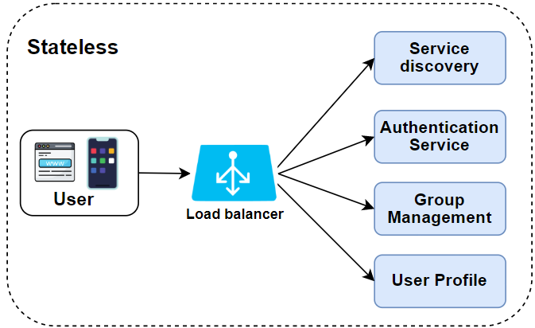
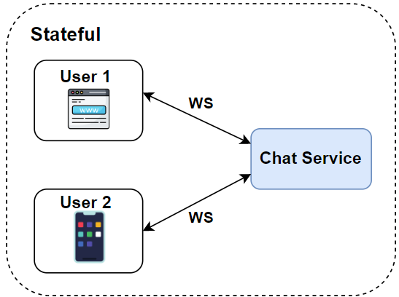
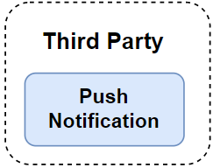
System Design
Notes:
Stateless Services
Stateless services are traditional public-facing request/response services, used to manage the login, signup, user profile, etc. These are common features among many websites and apps.
Stateless services sit behind a load balancer whose job is to route requests to the correct services based on the request paths. These services can be monolithic or individual microservices.
We do not need to build many of these stateless services by ourselves as there are services in the market that can be integrated easily. The one service that we will discuss more in deep dive is the service discovery. Its primary job is to give the client a list of DNS host names of chat servers that the client could connect to.
Stateful Service
The only stateful service is the chat service. The service is stateful because each client maintains a persistent network connection to a chat server. In this service, a client normally does not switch to another chat server as long as the server is still available.
The service discovery coordinates closely with the chat service to avoid server overloading. We will go into detail in deep dive.

Slide 24
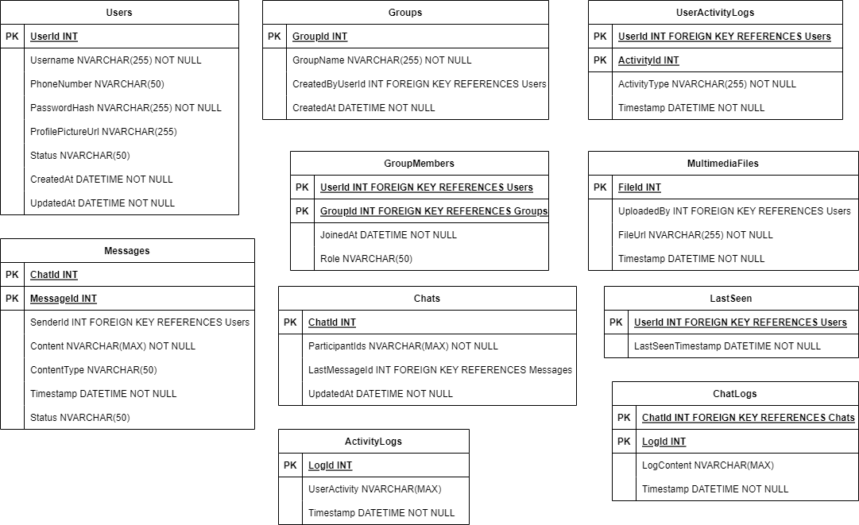
Database Design
Notes:
Users: user_id, username, phone_number, password_hash, profile_picture_url, status, created_at, updated_at.
Groups: group_id, group_name, created_by_user_id, created_at.
Group_Members: group_id, user_id, joined_at, role.
Messages: message_id, chat_id, sender_id, content, content_type, timestamp, status.
Chats: chat_id, participant_ids, last_message_id, updated_at.
Last_Seen: user_id, last_seen_timestamp.
Multimedia_Files: file_id, uploaded_by, file_url, timestamp.
User_Activity_Logs: activity_id, user_id, activity_type, timestamp.
Chat_Logs: Storage for historical chat data.
Activity_Logs: Stores user activity logs for analysis.

Slide 25
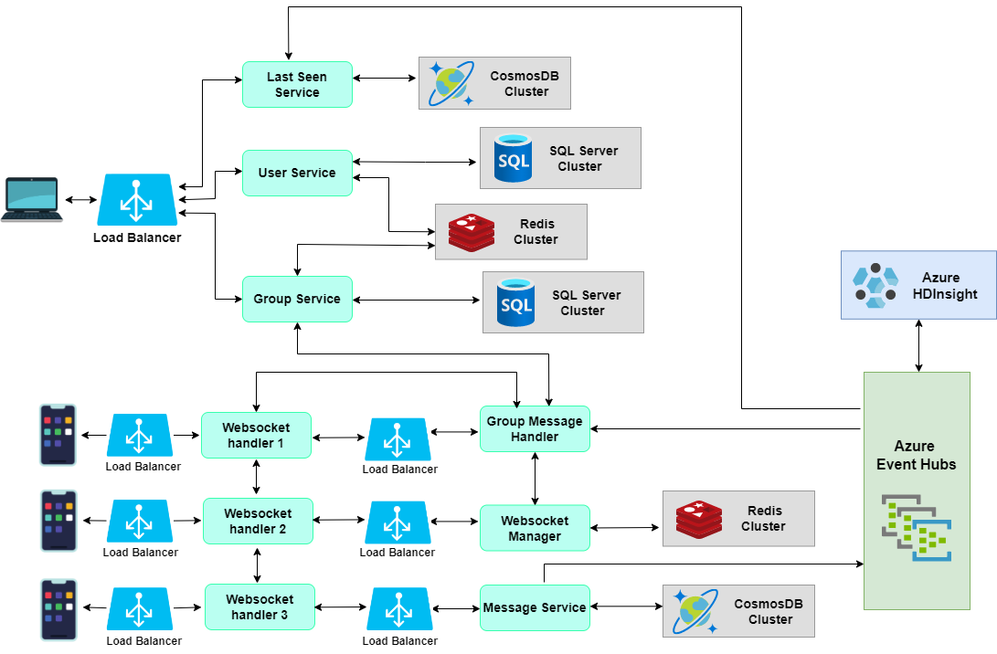
System Design

Slide 26
Instagram App like System Design

Slide 27
#3. Design Instagram like App
Problem Statement: Create a photo-sharing application like Instagram where users can post images and follow other users. The main feed will display a curated selection of the best images from followed users.
Out of the Scope: Features such as photo tagging, search by tags, user mentions in photos, commenting, and follow suggestions will not be included.

Slide 28
System Requirements and Goals
Functional Requirements
  A functionality for users to upload, download, and view photographs.
  A search feature that allows users to find photographs and videos by their titles.
  A following system where users can follow other user accounts.
  Curate and display a News Feed for each user, showing the most engaging photographs from accounts they follow.
Non-functional Requirements
  Our service must be high available to ensure users can access it at any time.
  The acceptable latency of the system should be 200ms for News Feed generation.
  The system should be highly reliable means any uploaded photo should not be lost.

Slide 29
System Design Considerations
The system is expected to be read-intensive; emphasis will be placed on constructing an architecture optimized for rapid photo retrieval.
Users will have the capability to upload an unlimited number of photos, necessitating a system design that prioritizes efficient storage management.
The system will be engineered to deliver photos with minimal delay.
Ensure complete data integrity, providing a guarantee that no uploaded photo will ever be misplaced or lost.

Slide 30
Capacity Estimation
Considering a user base 500 million, with 2 million active daily users
Consider each user on average share two photo every day and average image size is 200 KB.
Total photo shared for 1 day
  2M * 2 = 4 Million
Total space required for 1 day of photos
  4M * 200KB ≅ 762 GB
Total space required for 5 years:
  762 GB * 365 * 5 ≅ 1359 TB

Slide 31
Capacity Estimation: Assumption
Number of Active Users: The user base size greatly affects all calculations. Let's assume there are 100 million active users.
Daily Active Users (DAU): Let's assume 50% of total users are active daily, giving us 50 million DAU.
Post Creation Rate: Assume an average user posts twice per week. This results in 50M×2/7≈14.29M posts per day.
Post Size: Average text post size is 500 bytes, an image is 2MB, and 5% of posts are videos averaging 5MB.
Storage Growth Rate: Assume a 20% increase in posts year over year.
Engagement: Each post gets 100 new likes and 10 comments on average. A like is 1 byte to signify the event, and a comment is 140 bytes on average.

Slide 32
Capacity Estimation: Calculation
User Data Storage:
Assume 1KB per user profile: 100M x 1KB = 100GB
Post Data Storage:
Daily text posts: 14.29M x 500B = 7.145GB
Daily image posts: 14.29M x 2MB = 28,580GB
Daily video posts: 14.29M x 5% x 5MB = 3,572.5GB
Total daily post data: 7.145GB + 28,580GB + 3,572.5GB = 32,159.645GB
Annual post data: 32,159.645GB x 365 ≈ 11,738,270.425GB
Timeline Service:
If each user follows 500 others, the daily timeline updates: 50M x 500 x 2MB ≈ 50TB (not stored but streamed through the system)
CDN and Asset Storage:
Assuming each user views 200 images and 10 videos daily:
50M x 200 x 2MB ≈ 20PB for images and 50M x 10 x 5MB = 2.5PB for videos streamed per day.

Slide 33
Capacity Estimation: Calculation
Short URL Service:
If each post generates one short URL of 10 bytes, daily: 14.29M x 10B ≈ 0.143GB
This data is transient and can be purged frequently.
Engagement Data Storage:
Daily likes: 14.29M x 100 = 1.429GB
Daily comments: 14.29M x 10 x 140B ≈ 20GB
Total daily engagement data: 1.429GB + 20GB = 21.429GB
Redundancy and Backups:
Let’s add 50% more space for redundancy and backups: (11,738,270.425GB + 21.429GB) x 1.5
Bandwidth:
Assuming each user uses about 50MB/day: 50M x 50MB = 2.5PB inbound (for uploads) and 50M x (200 x 2MB + 10 x 5MB) = 22.5PB outbound per day.

Slide 34
Capacity Estimation: Summary
Total Annual Storage Requirement (without redundancy and backups):
User Data + Post Data + Engagement Data = 100GB + 11,738,270.425GB + 21.429GB
With redundancy and daily usage:
Total Storage + CDN Assets streamed per day = [11,738,391.854GB x 1.5] + 22.5PB

Slide 35
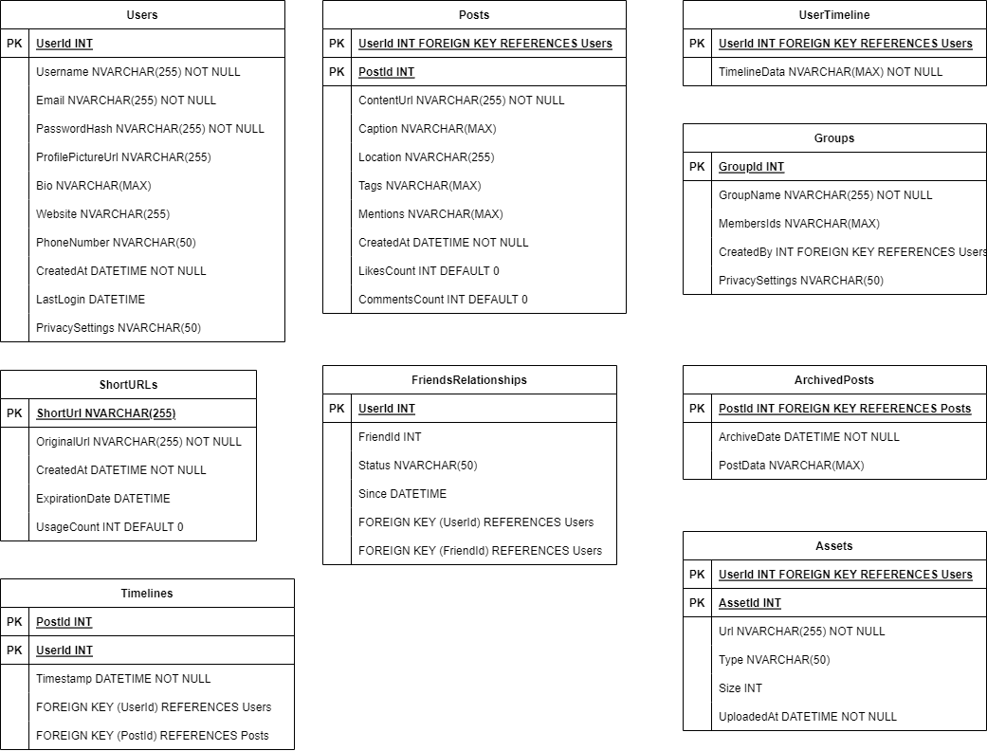
Database Design
Notes:
Users: user_id, username, email, password_hash, profile_picture_url, bio, website, phone_number, created_at, last_login, privacy_settings.
Posts: post_id, user_id, content_url, caption, location, tags, mentions, created_at, likes_count, comments_count.
User_Timeline: user_id, timeline_data, which includes post IDs and other relevant metadata in a time-series fashion.
Assets: asset_id, url, type, size, user_id, uploaded_at.
Short_URLs: short_url, original_url, created_at, expiration_date, usage_count.
Friends_Relationships: user_id, friend_id, status, since.
Groups: group_id, group_name, members_ids, created_by, privacy_settings.
Archived_Posts: post_id, archive_date, post_data.
Timelines: Sorted sets with user_id as the key and post_ids scored by timestamp.

Slide 36
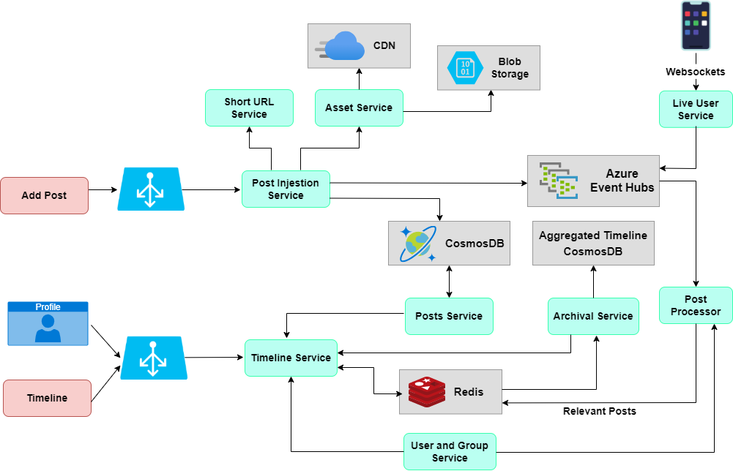
System Design

Slide 37
Booking.com like Hotel Reservation System Design

Slide 38
#4. Design A Booking.com Hotel Reservation System
Problem Statement: Develop a reliable and scalable hotel reservation system that provides seamless and real-time booking capabilities through both web and mobile interfaces. The system will allow users to search for hotels, compare prices, read reviews, view hotel amenities, and make reservations. The system must handle a high volume of simultaneous users and transactions without compromising performance.
Out of the Scope: The system will not support airline ticket booking, car rentals, or travel insurance services. Features like virtual reality tours of accommodations, personal travel assistant services, and integration with external entertainment booking systems will not be included in this version of the system.

Slide 39
System Requirements and Goals
Functional Requirements:
  Allow users to search for hotels based on various criteria such as location, dates etc.
  Provide detailed information about hotel, reviews, available rooms, pricing.
  Enable users to book and modify reservations, and the addition of special requests.
  Manage user profiles and booking history for ease of future bookings.
  Send confirmation details to users via email or SMS after a successful booking.
Non-functional Requirements:
  Ensure data accuracy and integrity, with real-time updates of room availability and prices.
  Able to handle high traffic volumes without performance degradation.
  Ensure the security of user data with industry-standard and compliance.
  A user-friendly interface that is responsive across various devices and screen sizes.
  Designed for high availability.

Slide 40
System Design Considerations
Ensure high availability and low latency to provide a smooth booking experience.
Design to handle a vast number of simultaneous search queries and booking transactions without degradation in performance.
Provide robust data consistency to ensure that the information on room availability and pricing is always accurate and up-to-date.
Data integrity is critical; all booking transactions must be reliably processed and stored to prevent any loss of reservation data.
The system should employ redundancy and failover mechanisms to maintain service continuity in case of any component failure.
Ensure that the system adheres to security best practices to protect user data.

Slide 41
Capacity Estimation
Considering a user base 500 million, with 2 million active daily users
Consider each user on average generate data of size 200 KB.
Total space required for 1 day of data
  2M * 200KB ≅ 381 GB
Total space required for 5 years:
  381 GB * 365 * 5 ≅ 679 TB

Slide 42
Capacity Estimation: Assumption
Assume 10 million listings
Average of 10 photos per listing, with each photo averaging 5MB
Each hotel has 300 bookings per year on average
Each booking record is approximately 1KB in size
Daily searches per user: 10
Average search size: 1KB
1 million active users daily
User activity data is 0.5KB per user per day

Slide 43
Capacity Estimation: Calculation
Storage for Listings:
Photos: 10 million listings * 10 photos/listing * 5MB/photo = 500TB
Listing Data: Since the data per listing (excluding photos) might include text and other metadata, let’s assume it’s 10KB per listing. So, 10 million listings * 10KB = 100GB
Storage for Bookings:
Bookings: 10 million listings * 300 bookings/listing/year * 1KB/booking = 3TB per year
Elasticsearch Cluster for Search Indexes:
Assuming we store copies of the listing data for search indexing, along with some additional metadata for faster searches.
Index Data: 10 million listings * 20KB (listing data + metadata) = 200GB
Daily Search Volume:
1 million users * 10 searches/user/day * 1KB/search = 10GB/day

Slide 44
Capacity Estimation: Calculation
Daily User Activity Data:
1 million users * 0.5KB/user/day = 0.5GB/day
Redundancy and Replication:
The data can replicate at least 3 times for high availability. So, the storage for listings, bookings, and search indexes needs to be tripled.
Backups:
Daily backups might add up to the equivalent of the daily change rate. If we assume that 0.1% of the listings are updated daily, then backups would be around 0.1% of the listings and photos per day.

Slide 45
Capacity Estimation: Summary
Total Storage Requirement (first year without considering growth rates):
Listings (excluding photos): 100GB * 3 (replication) = 300GB
Photos: 500TB * 3 (replication) = 1500TB
Bookings: 3TB/year * 3 (replication) = 9TB/year
Search Indexes: 200GB * 3 (replication) = 600GB
Backups: ~500GB/day * 365 = 182.5TB/year (for photos and listings)
Total = 1500TB + 9TB + 0.6TB + 182.5TB ≈ 1692.1TB in the first year
Bandwidth:
Assume that each listing’s photos are viewed 100 times per month, then we need to support: 10 million listings * 10 photos * 5MB * 100 views = 50PB of data transfer per month.

Slide 46
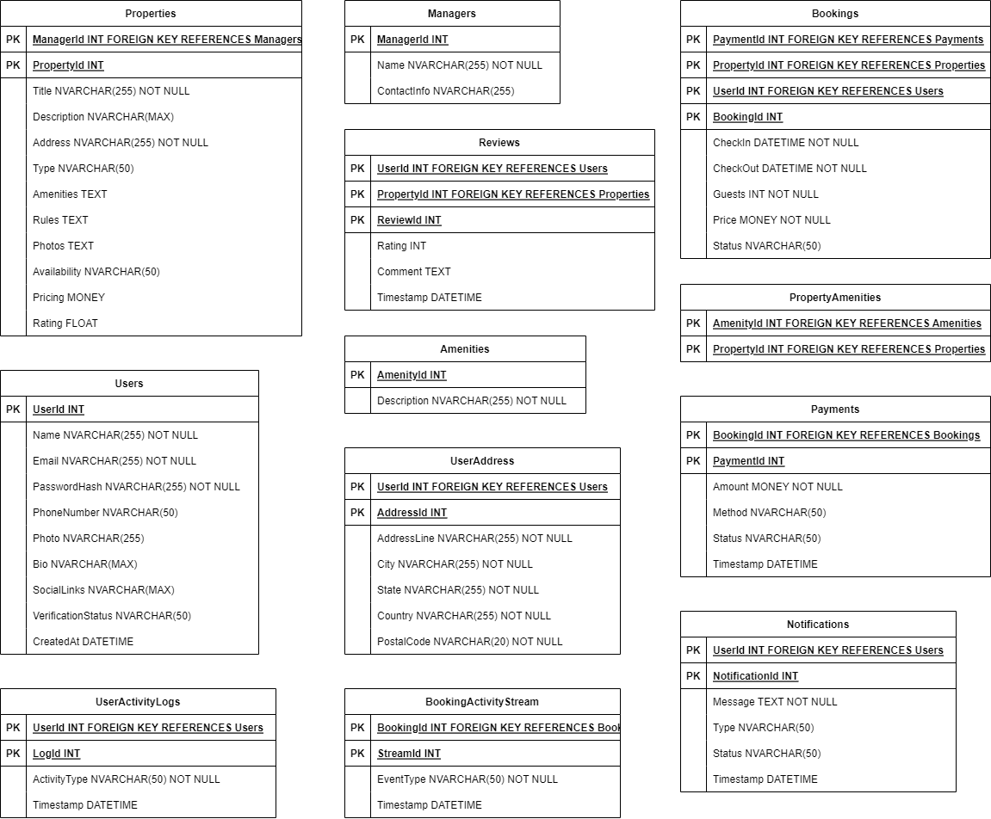
Database Design
Notes:
Properties: property_id, manager_id, title, description, address, type, amenities, rules, photos, availability, pricing, rating.
Managers: manager_id, name, contact_info.
Reviews: review_id, property_id, user_id, rating, comment, timestamp.
Amenities: amenity_id, description.
Property_Amenities: property_id, amenity_id (to handle the many-to-many relationship).
Bookings: booking_id, user_id, property_id, check_in, check_out, guests, price, status, payment_id.
Payments: payment_id, booking_id, amount, method, status, timestamp.
Users: user_id, name, email, password_hash, phone_number, photo, bio, social_links, verification_status, created_at.
User_Address: address_id, user_id, address_line, city, state, country, postal_code.
Notifications: notification_id, user_id, message, type, status, timestamp.
User_Activity_Logs: log_id, user_id, activity_type, timestamp.
Booking_Activity_Stream: stream_id, booking_id, event_type, timestamp.
Historical_Bookings: Files containing historical booking data partitioned by date or other relevant dimensions.
Property_Index: Designed for efficient text searches and filtering of properties based on location, amenities, availability, etc.

Slide 47
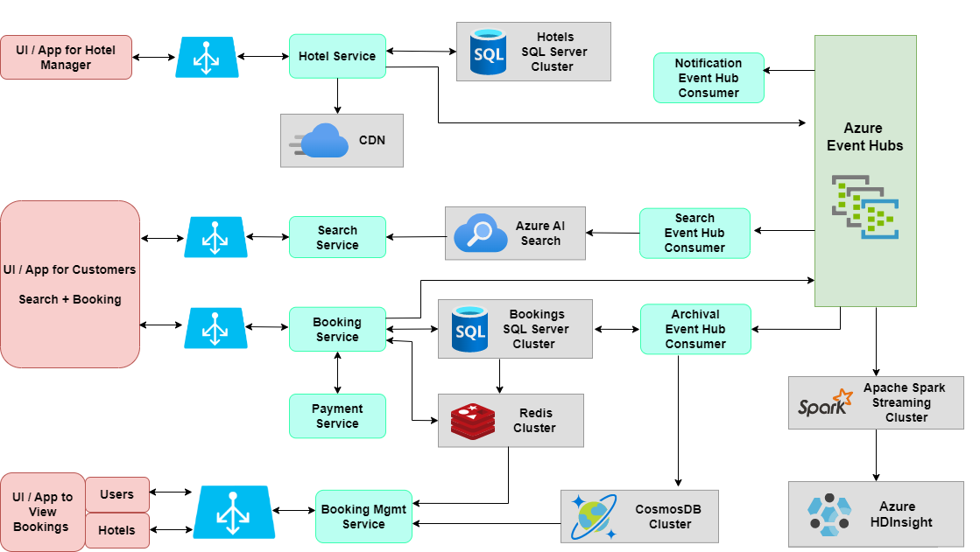
System Design
Notes:
Properties: property_id, manager_id, title, description, address, type, amenities, rules, photos, availability, pricing, rating.
Managers: manager_id, name, contact_info.
Reviews: review_id, property_id, user_id, rating, comment, timestamp.
Amenities: amenity_id, description.
Property_Amenities: property_id, amenity_id (to handle the many-to-many relationship).
Bookings: booking_id, user_id, property_id, check_in, check_out, guests, price, status, payment_id.
Payments: payment_id, booking_id, amount, method, status, timestamp.
Users: user_id, name, email, password_hash, phone_number, photo, bio, social_links, verification_status, created_at.
User_Address: address_id, user_id, address_line, city, state, country, postal_code.
Notifications: notification_id, user_id, message, type, status, timestamp.
User_Activity_Logs: log_id, user_id, activity_type, timestamp.
Booking_Activity_Stream: stream_id, booking_id, event_type, timestamp.
Historical_Bookings: Files containing historical booking data partitioned by date or other relevant dimensions.
Property_Index: Designed for efficient text searches and filtering of properties based on location, amenities, availability, etc.

Slide 48
OTT Platform System Design

Slide 49
#5. Design A Netflix Like Video Platform
Problem Statement: Design a robust and scalable video streaming platform like to Netflix to provides on-demand video streaming through web and mobile applications. The platform must offer features such as personalized recommendations, multiple profile support, and the ability to browse extensive libraries of movies, TV shows, and documentaries. It should support various video qualities, including standard definition (SD), high definition (HD), and 4K Ultra HD. The system needs to accommodate a substantial number of concurrent streams and user interactions while ensuring a high-quality viewing experience without buffering or interruptions.
Out of the Scope: The platform will not include live TV streaming, user-generated content uploads, or an integrated social media platform for sharing content and E-commerce functionalities.

Slide 50
System Requirements and Goals
Functional Requirements:
  Allow search for video content based on various criteria such as genre, release date, popularity, etc.
  Provide detailed information about video content, cast lists, reviews, and ratings.
  Enable users to stream video content.
  Support user profile management, personalized recommendations and watch history tracking.
  Send notifications to users about new content, subscription renewals etc.
Non-functional Requirements:
  Ensure the accuracy and integrity of data, with real-time updates to content availability and new releases.
  Capable of handling a high number of simultaneous streams and user interactions.
  Ensure the security of user data, including watch history and payment information, adhering to industry standards and regulatory compliance.
  A user interface accessible across various devices, including smart TVs, mobile, tablets, and web.
  Designed for high availability.

Slide 51
System Design Considerations
High Availability and Low Latency: Essential for uninterrupted streaming.
Scalability: To support numerous users and interactions without performance drops.
Data Consistency and Integrity: Accurate video metadata and secure user information are crucial.
Redundancy and Failover: To keep the service running smoothly even when parts fail.
Security: Use best practices to ensure data protection and privacy.
Content Delivery Network (CDN): For fast content delivery close to users.
Efficient Storage: To handle the vast size and variety of video content.
Content Protection: DRM systems to secure video content against piracy.
System Monitoring: For ongoing performance and security checks.

Slide 52
Capacity Estimation
Considering a user base 500 million, with 2 million active daily users
Consider each user on average generate data of size 400 MB.
Total space required for 1 day of data
  2M * 400MB ≅ 800 TB
Total space required for 5 years:
  800 TB * 365 * 5 ≅ 1460 PB

Slide 53
Capacity Estimation: Assumption
Number of subscribers: 200 million.
Average number of videos watched per subscriber per day: 2.
Average video file size: SD (480p) at 700MB, HD (1080p) at 3GB, and 4K (2160p) at 15GB.
Content library size: 100,000 titles (Movies & TV shows).
Average video length: 90 minutes.
Number of video formats per title: 3 (SD, HD, 4K).
Video retention time: Indefinite (as long as it is licensed).
Daily growth rate of videos: 50 titles per day.
Database record per video: 2KB.
User activity data per user per day: 20KB.

Slide 54
Capacity Estimation: Calculation
Video Content Storage:
Each title in SD: 700MB, HD: 3GB, 4K: 15GB.
Total for one title: 700MB + 3GB + 15GB = 18.7GB.
Content library storage: 100,000 titles * 18.7GB = 1,870,000GB or 1.87PB.
Daily new titles: 50 titles * 18.7GB = 935GB.
Annual growth: 935GB/day * 365 days = 341.275TB/year.
Database Storage:
Database record per video: 100,000 titles * 2KB = 200MB.
Daily growth: 50 titles * 2KB = 0.1MB.
Annual growth: 0.1MB/day * 365 days = 36.5MB/year.
Users DB and User Activity Data: 200 million users * 20KB = 4TB/day.
With a redundancy factor (e.g., replication factor of 3): 4TB * 3 = 12TB/day.

Slide 55
Capacity Estimation: Calculation
Bandwidth Estimation:
Two videos watched per subscriber per day: 200 million * 2 = 400 million streams/day.
Assuming an even distribution of quality preferences: 1/3rd SD, 1/3rd HD, 1/3rd 4K.
Daily bandwidth: (400 million / 3) * (700MB + 3GB + 15GB) ≈ 2,266,666 * 18.7GB = 42,386TB/day.
Compute Resources:
Assume an average of 10% of users are active concurrently during peak hours: 20 million users.
If one compute unit can handle 1,000 concurrent streams, then total compute units: 20 million / 1,000 = 20,000 compute units.

Slide 56
Capacity Estimation: Summary
Initial storage: 1.87PB for existing library.
Annual storage growth: 341.275TB for new titles.
Database storage: 4TB daily activity data, increasing by 12TB with redundancy.
Daily bandwidth required for streaming: 42,386TB.
Compute units required for peak concurrency: 20,000.

Slide 57
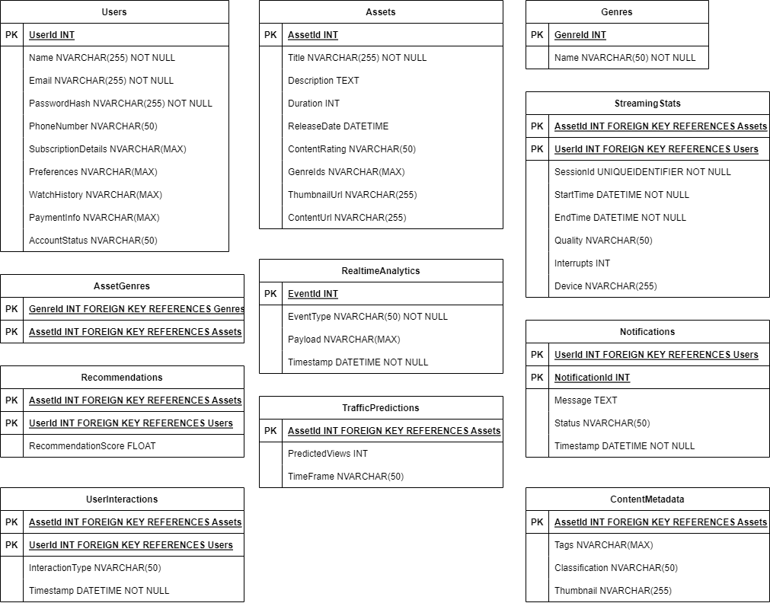
Database Design
Notes:
Users: user_id, name, email, password_hash, phone_number, subscription_details, preferences, watch_history, payment_info, account_status
Assets: asset_id, title, description, duration, release_date, content_rating, genre_ids, thumbnail_url, content_url
Genres: genre_id, name.
Asset_Genres: asset_id, genre_id
Content_Metadata: asset_id, tags, classification, thumbnail
Streaming_Stats: user_id, asset_id, session_id, start_time, end_time, quality, interrupts, device
Recommendations: user_id, asset_id, recommendation_score.
Traffic_Predictions: asset_id, predicted_views, time_frame.
Notifications: notification_id, user_id, message, status, timestamp.
User_Interactions: user_id, asset_id, interaction_type, timestamp.
Realtime_Analytics: event_id, event_type, payload, timestamp.
Assets_Index: Implement text searches on asset titles, descriptions, tags, and other metadata.

Slide 58
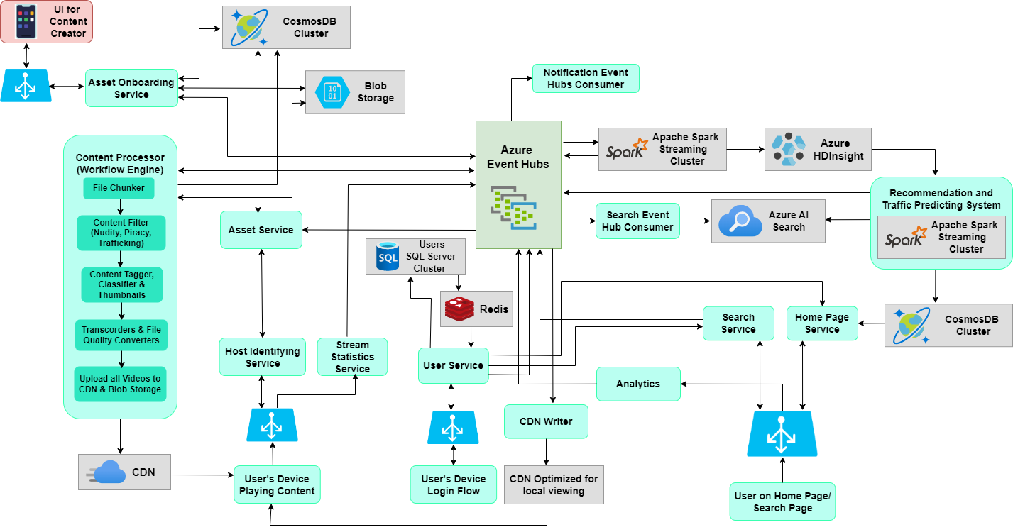
System Design
Notes:
Users: user_id, name, email, password_hash, phone_number, subscription_details, preferences, watch_history, payment_info, account_status
Assets: asset_id, title, description, duration, release_date, content_rating, genre_ids, thumbnail_url, content_url
Genres: genre_id, name.
Asset_Genres: asset_id, genre_id
Content_Metadata: asset_id, tags, classification, thumbnail
Streaming_Stats: user_id, asset_id, session_id, start_time, end_time, quality, interrupts, device
Recommendations: user_id, asset_id, recommendation_score.
Traffic_Predictions: asset_id, predicted_views, time_frame.
Notifications: notification_id, user_id, message, status, timestamp.
User_Interactions: user_id, asset_id, interaction_type, timestamp.
Realtime_Analytics: event_id, event_type, payload, timestamp.
Assets_Index: Implement text searches on asset titles, descriptions, tags, and other metadata.

Slide 59
Flipkart like Ecommerce System Design

Slide 60
#6. Design A Flipkart Like ECommerce Platform
Problem Statement: Design a robust and scalable e-commerce platform akin to Flipkart that provides an online marketplace through web and mobile applications. The platform must offer features such as personalized product recommendations, multiple user account management, and the ability to browse extensive catalogs of products across various categories such as electronics, fashion, home essentials, and more. The system needs to handle a high volume of concurrent users and transactions while ensuring a smooth shopping experience without lag or interruptions during browsing, cart management, and checkout processes.
Out of Scope: The platform will not include auction-based selling, cryptocurrency transactions, or an integrated blogging platform for community interactions and content marketing functionalities.

Slide 61
System Requirements and Goals
Functional Requirements:
  Search for products using filters like category, price, and brand.
  Display detailed product descriptions, reviews, and ratings.
  Manage shopping cart and user profiles.
  Process transactions and send order notifications.
Non-functional Requirements:
  Maintain data accuracy with real-time inventory and pricing updates.
  Scalable to support numerous users and transactions.
  Secure user data and comply with privacy standards.
  Ensure the platform works seamlessly across various devices.
  Designed for continuous operation with minimal downtime.

Slide 62
System Design Considerations
High Availability and Low Latency: Essential for uninterrupted streaming.
Scalability: To support numerous users and interactions without performance drops.
Data Consistency and Integrity: Accurate product metadata and secure user information are crucial.
Redundancy and Failover: To keep the service running smoothly even when parts fail.
Security: Use best practices to ensure data protection and privacy.
Content Delivery Network (CDN): For fast content delivery close to users.
Efficient Storage: For managing extensive product catalogs and user data efficiently.
System Monitoring: For ongoing performance and security checks.

Slide 63
Capacity Estimation
Considering a user base 500 million, with 2 million active daily users
Consider each user on average generate data of size 200 KB.
Total space required for 1 day of data
  2M * 200KB ≅ 381 GB
Total space required for 5 years:
  381 GB * 365 * 5 ≅ 679 TB

Slide 64
Capacity Estimation: Assumption
10 million products listed.
Each product has 5 high-resolution images, each around 500KB.
Each product has a description and metadata that takes up about 10KB.
Daily page views per product: 100.
Each page view is approximately 1MB (including images and content).
10 million daily active users.
On average, each user views 10 product pages per day.
Each user makes 2 searches per day, each search requiring about 5KB.
Each user has a 100KB user profile size.
1 million new items are added to the catalog per month.
5 million orders are processed each day, with each order record occupying about 1KB.

Slide 65
Capacity Estimation: Calculation
Storage for Products:
Image Storage: 10 million products * 5 images/product * 500KB/image = 25TB
Product Metadata: 10 million products * 10KB = 100GB
Daily User Traffic:
Page Views: 10 million users * 10 page views/user/day * 1MB/page view = 100TB/day
Searches: 10 million users * 2 searches/user/day * 5KB/search = 100GB/day
User Profile Storage:
User Profiles: 10 million users * 100KB/user = 1TB
Monthly Growth of New Products:
New Product Images: 1 million products/month * 5 images/product * 500KB/image = 2.5TB/month
New Product Metadata: 1 million products/month * 10KB = 10GB/month

Slide 66
Capacity Estimation: Calculation
Order Processing:
Orders: 5 million orders/day * 1KB/order = 5GB/day
Redundancy and Replication:
Data is typically replicated across multiple systems for high availability and disaster recovery.
Assuming a replication factor of 3, we triple the storage numbers.
Bandwidth:
For the images in product page views (assuming cached by CDN and not all coming from origin servers): 25TB * 3 (replication) * 100 views/product/day = 7.5PB/day.

Slide 67
Capacity Estimation: Summary
Initial Storage Requirement: ~26.1TB for product images and metadata, 1TB for user profiles.
Monthly Growth: ~2.51TB for new products, not including replication.
Total Storage with Replication: At least 78.3TB initially, growing monthly.
Daily Bandwidth: A significant portion of the 7.5PB/day would be handled by the CDN, but the origin bandwidth is still substantial and needs to be estimated based on cache hit/miss ratios.
Compute Resources: Need to be assessed based on the actual computational demand for user queries, order processing, and other services.

Slide 68
Database Design
Wishlists: wishlist_id, user_id, item_ids, created_at, updated_at.
Carts: cart_id, user_id, item_ids, quantities, timestamps.
Items: item_id, name, description, price, category_id, attributes, stock_level, ratings.
Inventory: inventory_id, item_id, warehouse_id, quantity_available.
Warehouses: warehouse_id, location, capacity.
Orders: order_id, user_id, item_ids, quantities, order_status, payment_id, shipment_id, order_date, estimated_delivery.
Payments: payment_id, order_id, amount, payment_method, payment_status.
Shipments: shipment_id, order_id, warehouse_id, carrier_id, tracking_number, status.
Order History: order_id, user_id, order_details, order_date, fulfillment_status.
Users: user_id, name, email, password_hash, address_id, phone_number, preferences, account_status.
Addresses: address_id, user_id, address_line, city, state, zip_code, country.
Pricing: item_id, base_price, discounts, seasonal_adjustments.

Slide 69
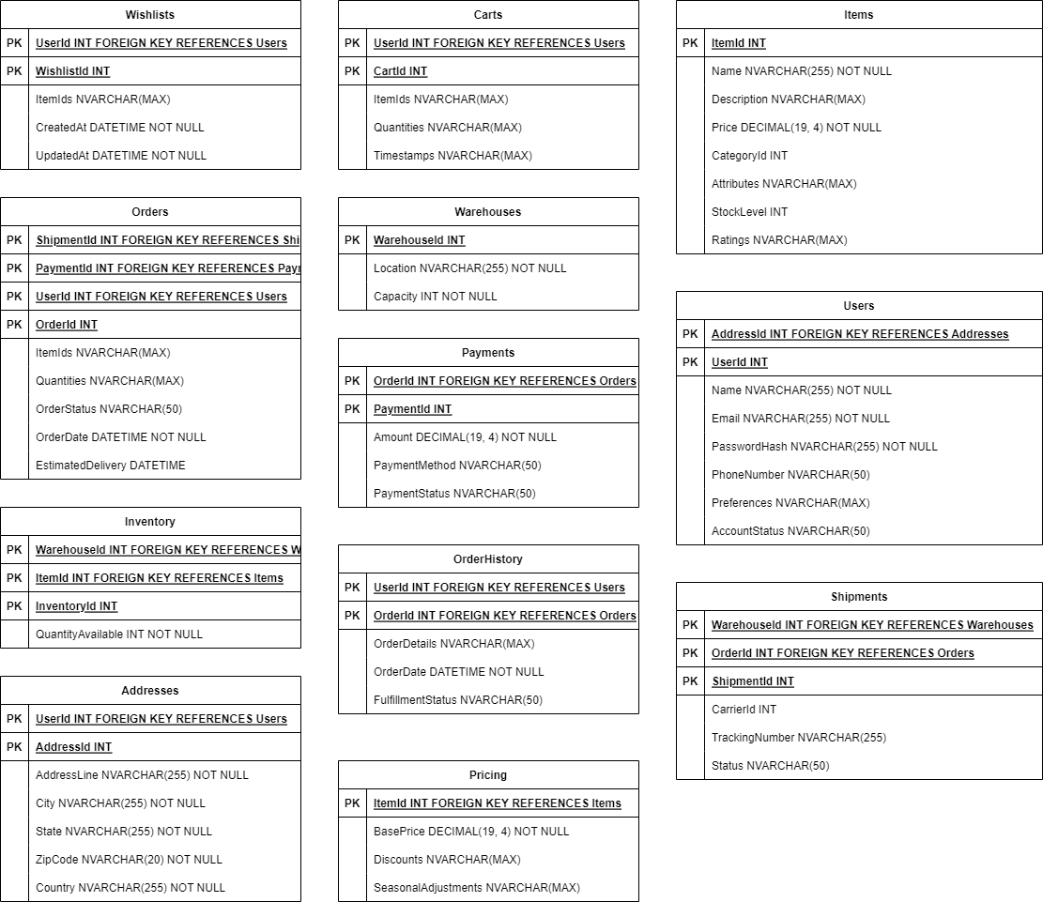
Database Design
Notes:
Wishlists: wishlist_id, user_id, item_ids, created_at, updated_at.
Carts: cart_id, user_id, item_ids, quantities, timestamps.
Items: item_id, name, description, price, category_id, attributes, stock_level, ratings.
Inventory: inventory_id, item_id, warehouse_id, quantity_available.
Warehouses: warehouse_id, location, capacity.
Orders: order_id, user_id, item_ids, quantities, order_status, payment_id, shipment_id, order_date, estimated_delivery.
Payments: payment_id, order_id, amount, payment_method, payment_status.
Shipments: shipment_id, order_id, warehouse_id, carrier_id, tracking_number, status.
Order History: order_id, user_id, order_details, order_date, fulfillment_status.
Users: user_id, name, email, password_hash, address_id, phone_number, preferences, account_status.
Addresses: address_id, user_id, address_line, city, state, zip_code, country.
Pricing: item_id, base_price, discounts, seasonal_adjustments.

Slide 70
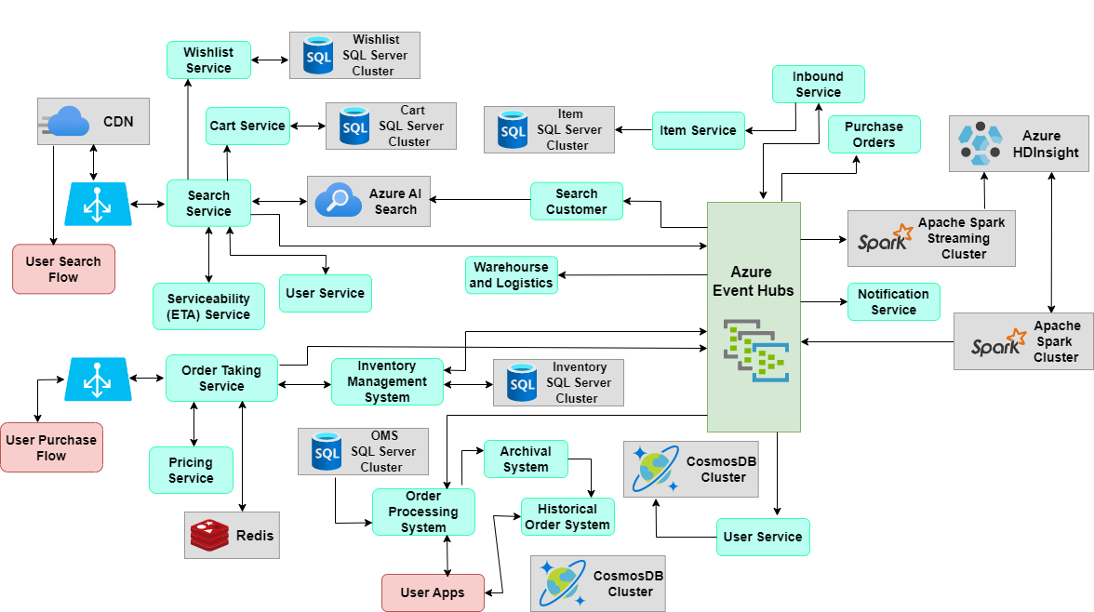
System
Design
Notes:
Wishlists: wishlist_id, user_id, item_ids, created_at, updated_at.
Carts: cart_id, user_id, item_ids, quantities, timestamps.
Items: item_id, name, description, price, category_id, attributes, stock_level, ratings.
Inventory: inventory_id, item_id, warehouse_id, quantity_available.
Warehouses: warehouse_id, location, capacity.
Orders: order_id, user_id, item_ids, quantities, order_status, payment_id, shipment_id, order_date, estimated_delivery.
Payments: payment_id, order_id, amount, payment_method, payment_status.
Shipments: shipment_id, order_id, warehouse_id, carrier_id, tracking_number, status.
Order History: order_id, user_id, order_details, order_date, fulfillment_status.
Users: user_id, name, email, password_hash, address_id, phone_number, preferences, account_status.
Addresses: address_id, user_id, address_line, city, state, zip_code, country.
Pricing: item_id, base_price, discounts, seasonal_adjustments.

Slide 71
OLA Like Taxi System Design

Slide 72
#7. Design An OLA Like Taxi System
Problem Statement: Design a robust and scalable taxi platform like to OLA that provides on-demand taxi services through web and mobile applications. The platform must offer features such as real-time GPS tracking of rides, personalized ride suggestions, multiple user account management, and the ability to browse various types of vehicles ranging from economical to luxury. The system should be capable of handling a high volume of concurrent ride requests and driver interactions while ensuring a seamless booking experience without delays or disruptions during ride matching, in-ride navigation, and payment processing.
Out of Scope: The platform will not include ride-sharing with strangers, transactions with cryptocurrencies, or an integrated social media platform for driver and rider interactions beyond the scope of ride services.

Slide 73
System Requirements and Goals
Functional Requirements:
  Search for available rides using filters like location, car type, and fare rates.
  Display detailed ride information like driver and vehicle details, and estimated arrival time.
  Manage user profiles and ride history.
  Process ride transactions and send ride notifications.
Non-functional Requirements:
  Maintain data accuracy with real-time location tracking and fare calculations.
  Scalable to support a high volume of concurrent ride requests and driver availability.
  Secure user data, and payment information, in compliance with privacy standards.
  Ensure the app works seamlessly across various devices, such as smartphones and tablets.
  Designed for continuous operation with minimal downtime, even during peak traffic hours.

Slide 74
System Design Considerations
High Availability and Low Latency: Essential for uninterrupted streaming.
Scalability: To support numerous users and interactions without performance drops.
Data Consistency and Integrity: Accurate video metadata and secure user information are crucial.
Redundancy and Failover: To keep the service running smoothly even when parts fail.
Security: Use best practices to ensure data protection and privacy for user and driver information.
Content Delivery Network (CDN): For fast content delivery close to users.
Efficient Storage: For managing extensive product catalogs and user data efficiently.
System Monitoring: For ongoing performance and security checks.

Slide 75
Capacity Estimation
Considering a user base 500 million, with 2 million active daily users
Consider each user on average generate data of size 100 KB.
Total space required for 1 day of data
  2M * 100KB ≅ 190 GB
Total space required for 5 years:
  190 GB * 365 * 5 ≅ 340 TB

Slide 76
Capacity Estimation: Assumption
Assume 1 million active drivers and 10 million active users.
Each driver completes an average of 10 trips per day.
Each trip record is approximately 1KB.
Location updates are sent every 30 seconds by each active driver.
Each location update is around 50 bytes.
User profiles average 1KB in size.
Each user searches for 3 trips per day, with each search request being around 1KB.
95% of trips result in payment transactions, each transaction record being 500 bytes.
Retention policy for trip data is 5 years.

Slide 77
Capacity Estimation: Calculation
Storage for Trips:
Trips per day: 1 million drivers * 10 trips/driver/day = 10 million trips/day.
Trip data per day: 10 million trips/day * 1KB/trip = 10GB/day.
Annual trip data: 10GB/day * 365 days/year = 3,650GB/year or 3.65TB/year.
5-year trip data: 3.65TB/year * 5 years = 18.25TB.
Storage for Location Updates:
Location updates per day: 1 million drivers * (24 hours * 60 minutes * 2 updates/minute) = 2,880 million updates/day.
Location data per day: 2,880 million updates/day * 50 bytes/update ≈ 144GB/day.
Annual location data: 144GB/day * 365 days/year ≈ 52.56TB/year.
Storage for User Profiles:
Total user profile data: 10 million users * 1KB/user = 10GB.

Slide 78
Capacity Estimation: Calculation
Storage for Payments:
Payment transactions per day: 10 million trips/day * 95% = 9.5 million transactions/day.
Payment data per day: 9.5 million transactions/day * 500 bytes/transaction ≈ 4.75GB/day.
Annual payment data: 4.75GB/day * 365 days/year ≈ 1.73TB/year.
Storage for Search Requests:
Search requests per day: 10 million users * 3 searches/user/day * 1KB/search = 30GB/day.
Annual search data: 30GB/day * 365 days/year = 10.95TB/year.
Redundancy and Replication:
Assuming trip data, location updates, payments, and search requests are replicated thrice for high availability, multiply the storage needs by three.

Slide 79
Capacity Estimation: Calculation
Bandwidth:
Assume average bandwidth consumption per trip is similar to search requests.
Daily bandwidth for trip requests: 30GB (as with search requests).
Daily bandwidth for location updates: 144GB (from location updates).
Compute Resources:
Based on the number of transactions (searches, trips, location updates), sufficient servers are required to handle the peak loads. If each server can handle 1,000 concurrent connections, then at least several hundred servers might be required.

Slide 80
Capacity Estimation: Summary
Storage required for trip records over 5 years: approximately 18.25TB, not including redundancy.
Annual storage required for location updates: approximately 52.56TB.
Total user profile data: approximately 10GB.
Annual storage required for payment records: approximately 1.73TB.
Annual storage required for search data: approximately 10.95TB.
Bandwidth: At least 174GB/day required to handle location updates and trip requests, not including user app traffic.
Compute resources: Several hundred servers to handle the peak loads, with precise numbers depending on actual performance tests.

Slide 81
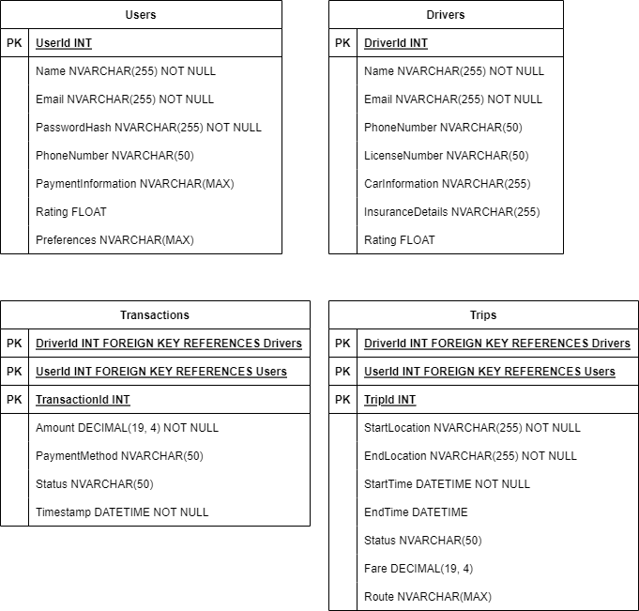
Database Design
Notes:
Users: user_id, name, email, password_hash, phone_number, payment_information, rating, preferences
Trips: trip_id, user_id, driver_id, start_location, end_location, start_time, end_time, status, fare, route
Drivers: driver_id, name, email, phone_number, license_number, car_information, insurance_details, rating
Transactions: transaction_id, user_id, driver_id, amount, payment_method, status, timestamp

Slide 82
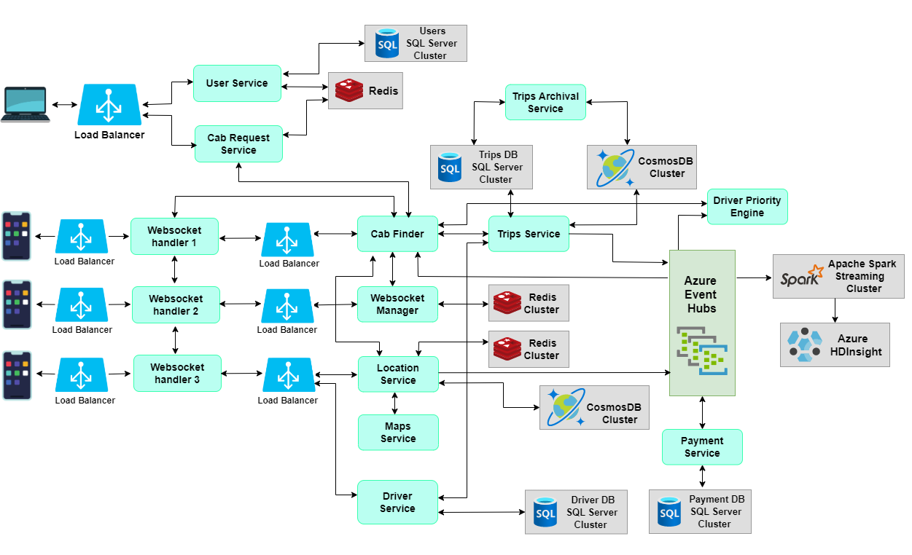
System Design
Notes:
Users: user_id, name, email, password_hash, phone_number, payment_information, rating, preferences
Trips: trip_id, user_id, driver_id, start_location, end_location, start_time, end_time, status, fare, route
Drivers: driver_id, name, email, phone_number, license_number, car_information, insurance_details, rating
Transactions: transaction_id, user_id, driver_id, amount, payment_method, status, timestamp

